Slide 1
EECS 2500 Linear Data Structures
Lecture 15
Chapter 07 – More Lists
Fall 2016
Dr. Larry G. Thomas – University of Toledo/LCCC

Slide 2
Welcome to EECS 2500
Pages of primary text in each chapter:
Ch. 1: 49 pp. (Getting Organized)
Ch. 2: 83 pp. (Abstract Data Types (ADTs))
Ch. 3: 80 pp. (The Stack ADT)
Ch. 4: 42 pp. (Recursion)
Ch. 5: 73 pp. (The Queue ADT)
Ch. 6: 75 pp. (The List ADT)
Ch. 7: 50 pp. (More Lists)
Ch. 8: 67 pp. (Binary Search Trees – skip)
Ch. 9: 48 pp. (Priority Queues, Heaps, and Graphs – skip)
Ch. 10: 67 pp. (Searching and Sorting Algorithms – partial)

Slide 3
Chapter Outline
7.1 – Circular Linked Lists
7.2 – Doubly Linked Lists
7.3 – Linked Lists with Headers and Trailers
7.4 – A Linked List as an Array of Nodes
7.5 – A Specialized List ADT
7.6 – Case Study: Large Integers

Slide 4

Circular Linked Lists (§7.1)
Circular Linked List: A list in which every node has a successor; the “last” element is succeeded by the “first” element, forming a ring

Slide 5
A More Efficient Approach
Adding and removing elements at the front of a list might be a common operation for some applications (such as a queue)
Our linked list approach supports these operations very efficiently
The previous linked list approach does not (we need to access the last element also).
We can fix this problem by letting our list reference point to the last element in the list rather than the first; now we have easy access to both the first and the last elements in the list.

Slide 6
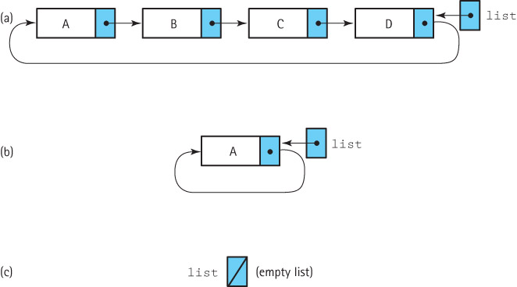
A More Efficient Approach - Illustrated

Slide 7
The CRefUnsortedList Class
The CRefUnsortedList class contains the same set of methods (size, contains, remove, get, toString, reset, and getNext) as its linear list counterpart RefUnsortedList.
The size method need not be changed.
If we provide a revised find helper method with functionality that corresponds to the find in RefUnsortedList, we can also reuse both the contains and get methods.

Slide 8
The Iterator Methods
The reset method gets (a little) more complicated and the getNext method gets simpler:
OLD NEW
public void reset() public void reset()
{ {
currentPos = list; if (list != null)
} currentPos = list.getLink();
}

Slide 9
The Iterator Methods (2)
The reset method gets (a little) more complicated and the getNext method gets simpler (there’s no special case for a null at the “end” of the list, because now there’s no end):
OLD NEW
public T getNext() public T getNext()
{ {
T next = currentPos.getInfo(); T next = currentPos.getInfo();
if (currentPos.getLink() == null) currentPos = currentPos.getLink();
currentPos = list; return next;
else }
currentPos = currentPos.getLink;
return next;
}

Slide 10
The toString Method
public String toString()
// Returns a nicely formatted String that represents this list.
{
String listString = "List:\n";
if (list != null)
{
LLNode<T> prevNode = list;
do
{
listString = listString + " " + prevNode.getLink().getInfo() + "\n";
prevNode = prevNode.getLink();
}
while (prevNode != list);
}
return listString;
}

Slide 11
The find Method
protected void find(T target)
{
location = list;
found = false;
if (list != null)
do
{
// move search to the next node
previous = location; // save current location
location = location.getLink();// advance current location
// check for a match
if (location.getInfo().equals(target)) found = true;
} while ((location != list) && !found);
}

Slide 12
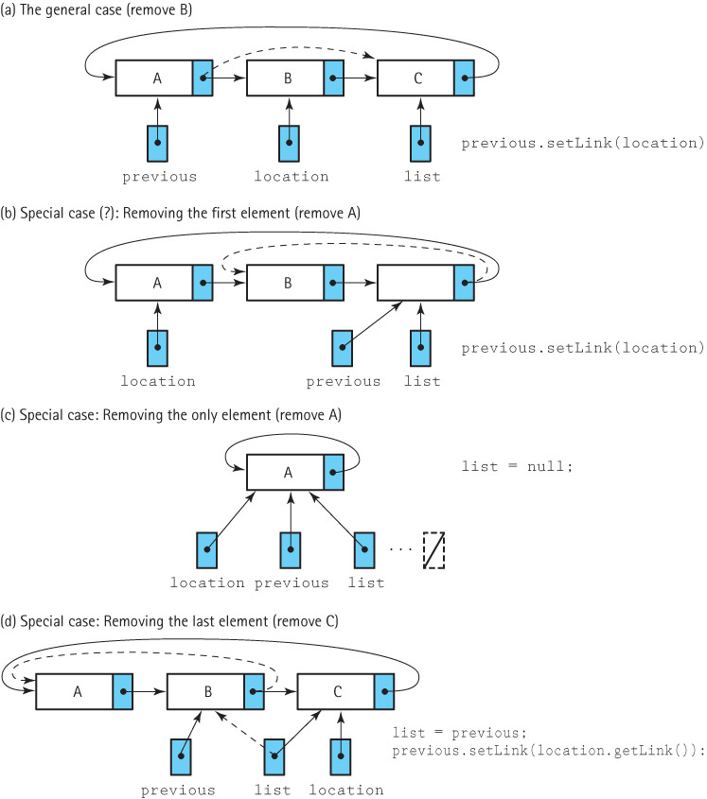
The remove Method
previous.setLink(location.getLink();
previous.setLink(location.getLink();
list = null;
list = previous;
previous.setLink(location.getLink();

Slide 13
The remove Method
public boolean remove (T element)
// Removes an element e from this list such that e.equals(element)
// and returns true; if no such element exists returns false.
{
find(element);
if (found)
{
if (list == list.getLink()) // if single element list
list = null;
else
{
if (previous.getLink() == list) // if removing last node
list = previous;
previous.setLink(location.getLink()); // remove node
}
numElements--; // regardless, there’s one fewer nodes now
}
return found;
}

Slide 14
The add Method
To implement the add method:
Create the new (LLNode)node
If adding to an empty list, set the list variable to reference the new element and link the new element to itself
Otherwise, add the element to the list in the most convenient place – at the location referenced by list
Increment numElements.

Slide 15
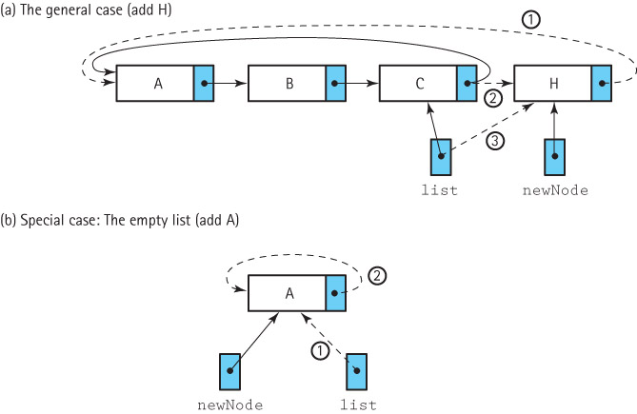
Adding a Node

Slide 16
The add Method
public void add(T element)
{
// Adds element to this list.
LLObjectNode newNode = new LLObjectNode(element);
if (list == null) // add element to an empty list
{
list = newNode;
newNode.setLink(list);
}
else
{
newNode.setLink(list.getLink()); // add to non-empty list
list.setLink(newNode);
list = newNode;
}
numElements++; // regardless, there’s one more node now
}

Slide 17
Doubly-Linked Lists (§7.2)
Doubly linked list: A linked list in which each node is linked to both its successor and its predecessor

Slide 18
DLLObjectNode Class
public class DLLNode<T> extends LLNode<T>
{
private DLLNode<T> back;
public DLLNode(T info) // constructor
{
super(info); // initialize the underlying node
back = null; // and initialize the back pointer to null
}
public void setBack(DLLNode<T> back)
// Sets back link of this DLLNode.
{
this.back = back;
}
public DLLNode<T> getBack()
// Returns back link of this DLLNode.
{
return back;
}
}

Slide 19
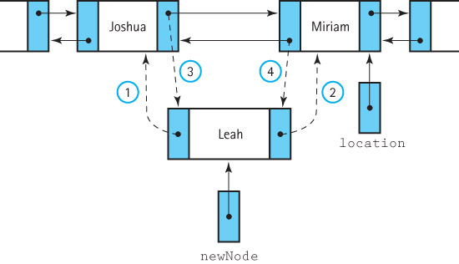
The add Operation

Slide 20
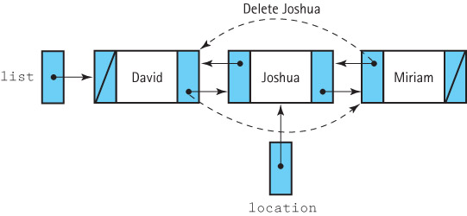
The remove Operation

Slide 21
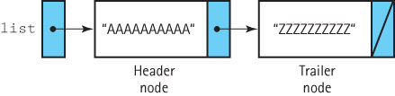
Linked Lists w/ Headers/Trailers (§7.3)
Header Node: A placeholder node at the beginning of a list; used to simplify list processing
Trailer Node: A placeholder node at the end of a list; used to simplify list processing

Slide 22
A Linked List as an Array of Nodes (§7.4)
WHAT?
We’ve implemented lists using arrays
We’ve implemented lists using linked nodes
How can we implement a list using an array of nodes?
Isn’t the array / node question either / or?
Not necessarily
Why use an array of nodes?

Slide 23
Why Use an Array?
There are times when dynamic allocation of each node, one at a time, is too costly in terms of time
There are programming languages that do not support dynamic allocation or reference types
Sometimes managing the free space ourselves gives us greater flexibility

Slide 24
Boundedness
A desire for static allocation is one of the primary motivations for the array-based linked approach
We drop our assumption that our lists are of unlimited size in this section - our lists will not grow as needed.
Applications should not add elements to a full list.
Our list will export an isFull operation, in addition to all the other standard list operations

Slide 25
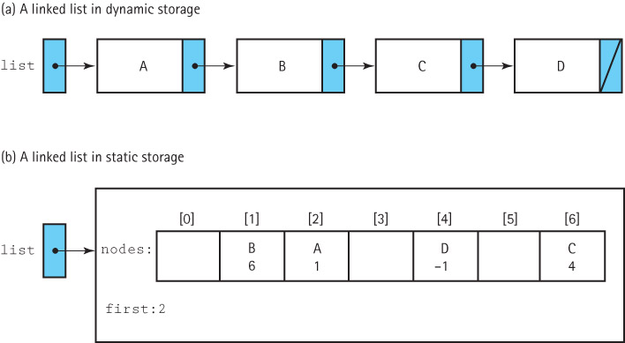
How It Works: In Memory

Slide 26
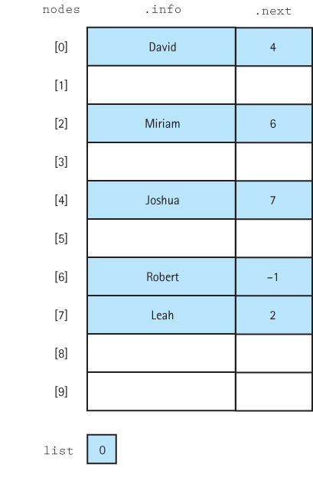
A Sorted List

Slide 27
Implementation Issues (1)
We mark the end of the list with a “null” value
the “null” value must be an invalid address for a real list element
we use the value –1 (array subscripts are ≥ 0)
we use the identifier (constant) NUL and define it to be -1
private static final int NUL = –1;

Slide 28
Implementation Issues (2)
If we’re declaring the array up-front at a fixed (maximum) size (static allocation), then we’ll never use new to allocate a new node.
So how do we know what locations we can use for “new” nodes?
Remember, this is a (general) list – not a stack or queue, so we can delete items from the middle of the list – how do we manage the “gap”?
“Closing” after delete / “opening” to insert

Slide 29
Implementation Issues (3)
We must directly manage the free space available for new list elements.
We link the collection of unused array elements together into a (second) linked list of free nodes.
Our array actually holds TWO linked lists at the same time – one of the nodes in use; one of the free nodes!
We write our own method to allocate nodes from the free space. We call this method getNode. We use getNode when we add new elements onto the list.
We write our own method, freeNode, to put a node back into the pool of free space when it is de-allocated.

Slide 30
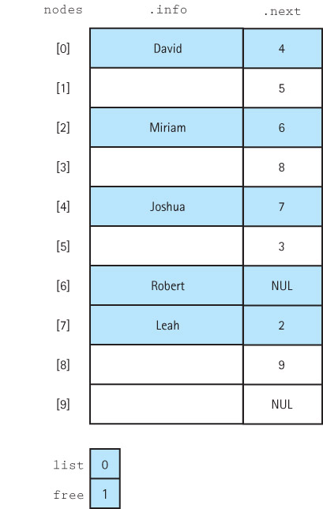
Two Lists – One Used; One Free

Slide 31
More Lists?
It’s possible to manage several lists in an array of nodes like this.
As long as we have a variable that tells us where each list starts, we can have several “chains” we can track from node-to-node
One needs to be the “free list”, and the remainder can be whatever we want.

Slide 32
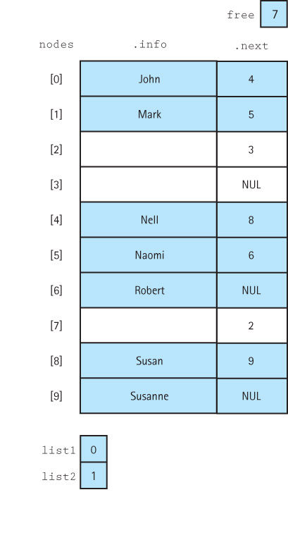
Two “Data” Lists + One “Free” List

Slide 33
The ArrayRefSortedStringList Class
The code for the class is too large to fit on a slide.
It can be found on pages 494 – 497 of the textbook.

Slide 34
A Specialized List ADT (§7.5)
We’ve seen general (unsorted), sorted, and indexed lists
The text sets up a new, specialized version of the list ADT in Section 7.5
We need a list that holds byte data types, rather than generic Objects
We don’t need the isFull(), contains(), get(), or remove() methods.
All we really need is size() and the iterator operations

Slide 35
Our New List ADT
We will have to be able to move forward and backwards through the list
So it needs to be doubly-linked
Not only do we need “next” iterator, we need “prev”
We build a new interface:
void resetForward()
void resetBackward()
byte getNextElement()
byte getPriorElement()
int size()
void addFront(byte element)
void addEnd(byte element)
See the text for the code (pp. 500 – 504)

Slide 36
Case Study: Large Integers (§7.6)
byte: -128 to +127
short: -32,768 to +32,767
int: -2,147,483,648 to +2,147,483,647
long: -9,223,372,036,854,775,808 to +9,223,372,036,854,775,807
What if we need to go larger still?
Java already has a java.math.BigInteger class!

Slide 37
Case Study: Large Integers (§7.6)
Why might we ever need to go larger still?
Java’s long data type can hold a 19-digit integer
What could possibly require an even larger variable?
Public-key cryptography (used to make https:// connections) depends on being able to generate prime numbers in the 150+ digit range, and then multiply them together for a 300-digit number!
Even Java’s long data type gets lost in the dust when we start talking about 150-digit numbers!

Slide 38
Case Study: Large Integers (§7.6)
An integer is a list of digits, so why don’t we just build a linked list of the individual digits?
Our constructor can’t initialize the data structure with a particular number directly – no numeric data type can hold a “huge” integer!
So, we need an addDigit method
Since we’re setting digits one-at-a-time, we also need to be able to set the number as being positive or negative (as in a calculator’s +/- key)
Our constructor can take a string, and read it one character at a time to add digits!

Slide 39
Large Integers
Our constructor will read a string left-to-right (most-significant-digit to least-significant-digit) to initialize it
Addition and subtraction, however, are performed right-to-left (least- to most-significant-digit)
We need to be able to insert at either end of the list
The LargeInt class is on pp. 508 – 518.

Slide 40
Working With Large Integers
General addition is straightforward – add the two numbers
Subtraction requires us to subtract the smaller (in magnitude) from the larger, and then sign rules tell us if the result is positive or negative
We need a method to compare two huge integers to tell which is larger
If the LargeInts have different numbers of digits, we can tell immediately which is larger
If they have the same number of digits, we look left-to-right until we get a mismatch

Slide 41
Working With Large Integers
To add two LargeInts, we work right-to-left, adding two digits together, and perhaps generating a carry to the next digit’s position
The code for addLists is on pp. 513 – 514
This adds two positive LargeInts
To subtract, we work right-to-left, and rather than a carry, we may need to borrow. Because we’ve already assured that we’re subtracting the smaller from the larger, there WILL be a digit to borrow from.

Slide 42
Addition Rules
Given two operands A and B:
If both are +, add |A| and |B|; result is +
If both are –, add |A| and |B|; result is –
If one is + and one is –, subtract the one with the smaller absolute value from the other, and give the result the sign of the larger of the two
The final add/subtract code is on pp. 517 – 518
See the documentation on the BigInteger class – it supports a surprisingly large number of operations!

Slide 43
End of Chapter 7
? Questions ?

